Slide 1
Different Stages of Turnaround
This slide portrays information regarding the different stages of turnaround that firm can use in order to recover from distress such as financial distress, poor sales, etc.
Management Change
01
Transitional changes suggested by board of directors or senior management
Add text here
Return – to – Normal Growth
Evaluation
02
Diagnosis of nature and extent of problems
Action plan is developed
Add text here
05
Firm operations normalized
Add text here
Stages
Stabilization
03
Emergency
Resolving immediate issues
Improve strategic and operating performance
Liquidation, sales or merger options are determined
Add text here
Necessary steps taken by firm at brink in order to survive
Add text here
04
This slide is 100% editable. Adapt to your needs and capture your audience attention

Slide 2
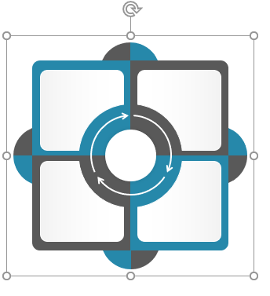
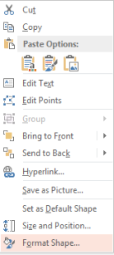
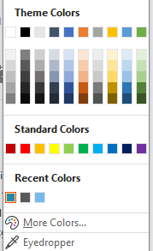
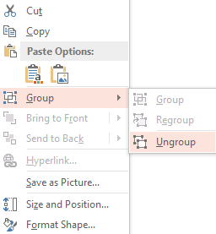
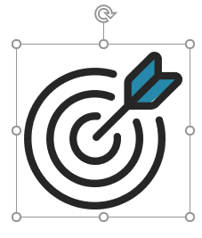
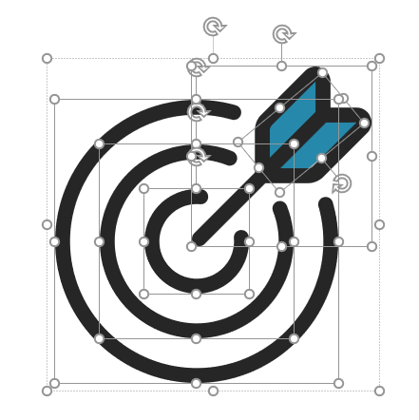
Instructions to Edit This Slide
Edit any Shape
Resize any Shape and Edit Color
1.
2.
3.
This slide has been made in PowerPoint using basic PowerPoint shapes, and all graphics are 100% editable in PowerPoint.
You can change color, size and orientation of any element to your liking, and add/edit any piece of text anywhere.
Use your Own Icons in any Slide
Select from Thousands of Editable Icons on Every Topic
These icons are available at the Icons section on www.slideteam.net
1.
2.
3.

